Slide 1

What is nonclassical about uncertainty relations?
Gdańsk - 03/08/2022
Lorenzo Catani
Joint work with Matt Leifer, Giovanni Scala, David Schmid and Rob Spekkens
arXiv:2207.11779

Slide 2
What is contextual about uncertainty relations?
Gdańsk - 03/08/2022
Lorenzo Catani
Joint work with Matt Leifer, Giovanni Scala, David Schmid and Rob Spekkens
arXiv:2207.11779

Slide 3
Contents
Motivation
Uncertainty relations
Operational theories
Ontological models and Noncontextuality
Main result
Conclusion

Slide 4
Contents
Motivation
Uncertainty relations
Operational theories
Ontological models and Noncontextuality
Main result
Conclusion

Slide 5
Motivation
Motivation
The basic phenomenology of features usually considered as truly nonclassical is exhibited in theories admitting of a noncontextual ontological model.
2/27

Slide 6
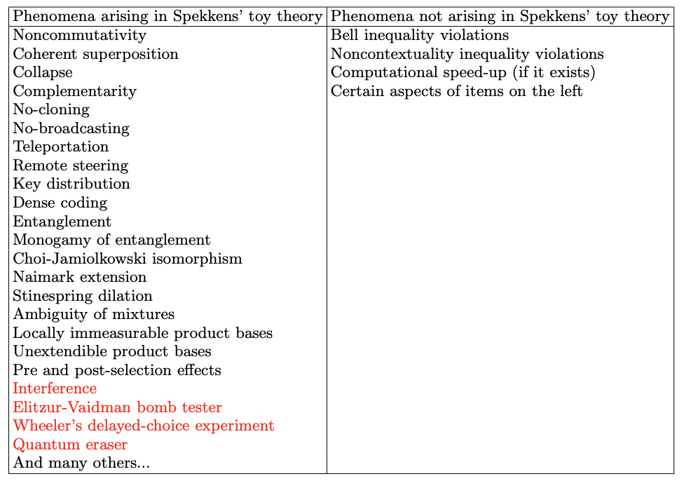
Motivation
Motivation
R. W. Spekkens, in Quantum Theory: Informational Foundations and Foils, pp 83-135, Springer Dordrecht (2016).
3/27
*L. Catani, M. Leifer, D. Schmid and R.W. Spekkens, arXiv:2111.13727 (2021).
Notes:
The red ones are novel with respect to the table in Spekkens’ paper.

Slide 7
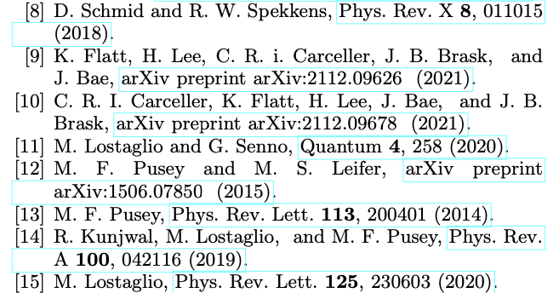
Motivation
Motivation
The basic phenomenology of features usually considered as truly nonclassical is exhibited in theories admitting of a noncontextual ontological model.
Which aspects of those phenomena witness contextuality?
4/27

Slide 8
Motivation
Motivation
There exist theories that manifest uncertainty relations but also admit of a noncontextual ontological model.
Which aspects of uncertainty relations witness contextuality?
5/27
Notes:
Which aspects of uncertainty relations, if any, witness nonclassicality, here in the form of contextuality?

Slide 9
Contents
Motivation
Uncertainty relations
Operational theories
Ontological models and Noncontextuality
Main result
Conclusion

Slide 10
Uncertainty relations
“Product” uncertainty relations in quantum theory
H.P. Robertson (1903-1961)
W. Heisenberg (1901-1976)
6/27
Notes:
1) Heisenberg-Robertson UR bounds the variances of two observables with the expectation value of their commutator (also Schrodinger improved this, but still has the same problem below).
About joint predictability of two measurements on a state. So like us, not like error-disturbance UR, about trade-off between info gain and disturbance.
2) However these are unsatisfactory in the finite dimensional case.
Both expectation value of variances are calculated on a state psi. So imagine that A and B are Pauli X and Z, and you choose as psi one of their eigenstate, e.g. of X, then this uncertainty relation is trivial. Even if the measurements are incompatible and have a tradeoff relation on their predictabilities for that state.
(Pair of measurements for which there is a nontrivial tradeoff in their predictabilities.
UR express limits on the extent to which the outcomes of distinct measurements on a single state can be made jointly predictable.)

Slide 11
Uncertainty relations
“Sum” uncertainty relations in quantum theory
In the case of Pauli and measurements,
.
Given that and
‘
7/27
Notes:
A solution to the above is to consider sums instead of products. For this talk we consider Pauli X and Z measurements, that are complementary and are the discrete analogue of position and momentum. In general, our results will hold for any two binary-outcome measurements.
This tradeoff relation holds for any state in quantum theory, and so it is an uncertainty relation. Its validity comes from the fact that it is a description of the Bloch ball of qubit quantum states.
Other versions of these are the entropic UR. Connected to ours, but we do not deal with them. I can spend some words later on them.

Slide 12
Contents
Motivation
Uncertainty relations
Operational theories
Ontological models and Noncontextuality
Main result
Conclusion

Slide 13
Operational theories
Operational theories
Operational theory in a prepare and measure scenario:
Preparation
Measurement and outcome
Predicted statistics
8/27
Notes:
An operational theory in a prepare and measure stipulates the preparations the measurements and an algorithm for computing the predicted probabilities of an outcome given preparation and measurement for all possible preparations and measurements.
We can imagine that each preparation and measurement effect as a real-valued vectors, and the probability is given by their inner product.

Slide 14
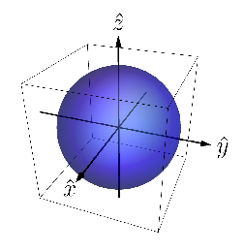
Operational theories
Operational theories – examples
Qubit theory
9/27
Notes:
In particular we consider simple examples. We start with the state-space representation of the qubit, which is the standard Bloch sphere. In R3 we represent a 4-dimensional space of Hermitian operators. Every qubit operator is represented as a linear combination of elements of a basis of the 4-dimensional space of Hermitian operators.
The expectation values of X and Z are linearly related to the probability of getting X and Z, and so with the projections of the state space on those axes.

Slide 15
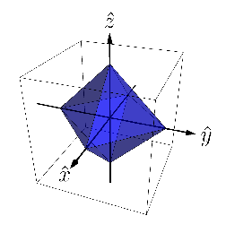
Operational theories
Operational theories – examples
Stabilizer theory
10/27
Notes:
Stabilizer states = eigenstates of Pauli observables and their closure. Same for the effects.
The expectation values of X and Z are linearly related to the probability of getting X and Z, and so with the projections of the state space on those axes.

Slide 16
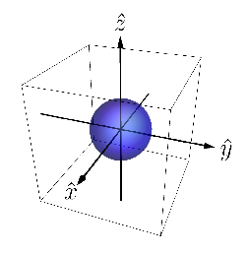
Operational theories
Operational theories – examples
depolarized qubit theory
11/27
Notes:
Full set of qubit effects, but restricted state space under the eta depolarizing map, which is just the channel that maps any state in the bloch sphere to a mixture of the same state and the completely mixed state, with probabilities (1-eta) and eta.
The expectation values of X and Z are linearly related to the probability of getting X and Z, and so with the projections of the state space on those axes.

Slide 17
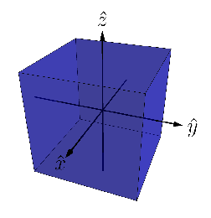
Operational theories
Operational theories – examples
Gbit theory
12/27
Notes:
Gbit theory where one can get full predictability jointly for X, Y, Z. Effect space is the same as qubit quantum theory.
X, Z perfectly predictable jointly.
The expectation values of X and Z are linearly related to the probability of getting X and Z, and so with the projections of the state space on those axes.

Slide 18
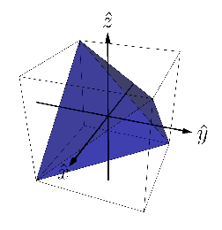
Operational theories
Operational theories – examples
Simplicial theory
13/27
Notes:
Classical theory of a pair of classical random variable, which we denote with X and Z. State space is convex hull of 4 possible joint assignments of values to X and Z (tetrahedron), while the effect space is the dual to this simplex (the hypercube).
X, Z perfectly predictable jointly.
The expectation values of X and Z are linearly related to the probability of getting X and Z, and so with the projections of the state space on those axes.

Slide 19
Operational theories
Examples: comparison of uncertainty relations
Legend
14/27
Notes:
The ii is gonna be clear in a bit why it’s red. For now imagine that they’re all blue. Predictability of X and of Z plotted.
The expectation values of X and Z are linearly related to the probability of getting X and Z, and so with the projections of the state space on those axes.

Slide 20
Contents
Motivation
Uncertainty relations
Operational theories
Ontological models and Noncontextuality
Main result
Conclusion

Slide 21
Ontological models and Noncontextuality
Ontological model of an operational theory
Each system ontic state space describing possible ontic states .
Preparation
Measurement and outcome
Predicted statistics
15/27
Notes:
The theory predicts well because there’s actual system that is subjected to the experimental procedures. It has physical properties defined as ontic states.
Since we consider Lambda finite, we can represent the probability distributions as vectors.

Slide 22
Ontological models and Noncontextuality
Preparation noncontextuality
Two preparations are operationally equivalent, , if
In a preparation noncontextual ontological model,
In particular,
R.W. Spekkens, Phys. Rev. A 71, 052108 (2005)
16/27
Notes:
Where the w_i are probability distributions.
I presented the notion for preparations but it extends also to transformations and measurements and it is known as generalized contextuality.
Of the examples before, qubit QT, gbit theory and eta-depolarizing qubit theory when eta less than 2/3 do not admit of NC ontological model. Simplicial and stabilizer yes.

Slide 23
Ontological models and Noncontextuality
Why is it a good notion of classicality?
Instance of Leibnizian methodological principle / no-fine tuning.
Connected to locality and Kochen-Specker noncontextuality.
Connected to positivity of quasiprobability representations.
Connected to simplex embeddability in GPTs.
Emerges in the presence of sufficient noise.
It is empirically testable.
Its violation is connected to quantum computational advantages.
*watch David Schmid’s lectures at Solstice of Foundations or see references in our article.
17/27
Notes:
Applies to a broad class of physical scenarios. For ex a single system unlike locality.
Simplex embeddability is the notion of classical explainability in GPTs.

Slide 24
Contents
Motivation
Uncertainty relations
Operational theories
Ontological models and Noncontextuality
Main result
Conclusion

Slide 25
Main result
How to link uncertainty relations and contextuality?
Problem:
Uncertainty relations single state.
Contextuality requires operational equivalences (at least 4 states).
18/27
Notes:
An UR expresses the predictability tradeoff between two measurements for any single state in the theory.
Contextuality requires at least 4 states (and two tomographically complete measurements like X and Z here).

Slide 26
Main result
How to link uncertainty relations and contextuality?
Solution:
Consider uncertainty relations for a state that satisfies the condition of
.
19/27
Notes:
Consider operational theories with a pair of joint measurements, denoted X,Z, and a state that satisfies the condition of A12 orbit realizability.

Slide 27
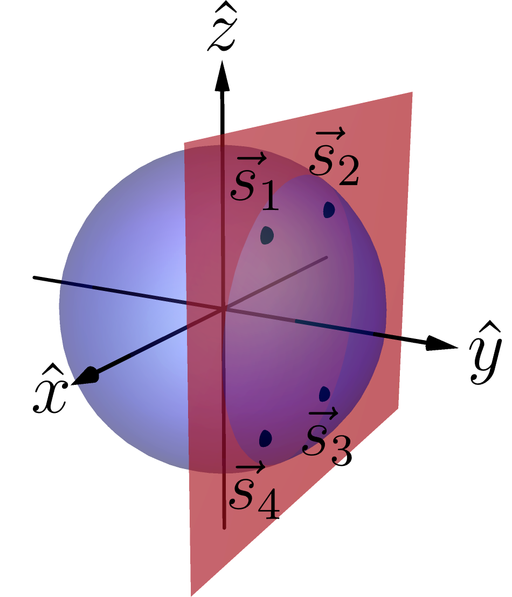
Main result
The condition
The state has equal predictability counterparts.
The state manifest operational equivalences with such counterparts.
Example in the qubit theory:
20/27
Notes:
i.e. there exists other states (at least other 3) that have the same predictabilities, in modulus, for X and Z. Other states manifest those predictabilities, so they also show the same uncertainty relation!
i.e. among these states there are at least 3 with which the state can have operational equivalence. Moreover, among these states there are operational equivalences.
So they lie in a rectangle in a plane parallel to the ZX plane. These vertices are the orbit of the original state under the action of the symmetry group of a rectangle under reflections, the Coxeter group A21. That’s why the name. Basically it’s a rectangle condition.

Slide 28
Main result
Main result
In any operational theory, if one can find a pair of measurements, , and a state that satisfies the condition of , then noncontextuality implies that .
21/27
Notes:
So noncontextuality imposes a nontrivial constraint on the X and Z predictabilities of a state.
Not doing the proof. It’s easily followable in the paper.
Noise robust. It can be tested experimentally.
So the UR it’s a NC inequality. It’s not about a single state as you could pick any in the A12 orbit realizability.
Despite our result shows contextuality of a theory whenever you have one state in your theory satisfying the symmetry and s.t. the bound is violated, our result has deeper significance for theories where all states satisfy the symmetry.

Slide 29
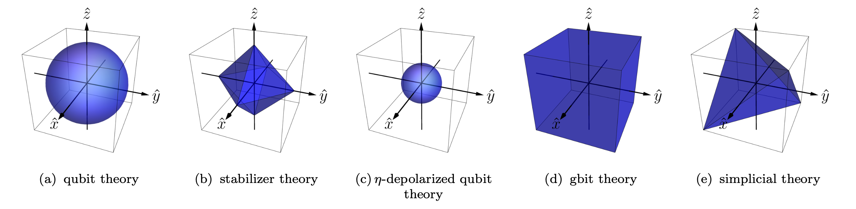
Main result
Theories with
If all states in an operational theory satisfy the condition of
we say that the theory has .
Examples:
22/27
Notes:
They all satisfy apart from simplicial. The set of states satisfying the A12 symmetry forms an octahedron inside the tetrahedron, whose vertices are at the midpoints of the edges, i.e. the stabilizer octahedron.
The vertices of the tetrahedron do not satisfy the symmetry, as they don’t manifest operational equivalences.
Notice, however, that our result applies to any theory with some state having A12 symmetry. Not only the theories that have all states satisfying it.
Thanks Giovanni for the very nice figures.

Slide 30
Main result
Noncontextuality and uncertainty relations
For theories that have our bound is a constraint on the form of the ZX-uncertainty relation within such theories.
23/27
Notes:
So noncontextuality implies the functional form of the uncertainty relation to be below a linear curve.
Our bound is a universal constraint on the predictability tradeoff within such theories.

Slide 31
Main result
Examples: comparison of uncertainty relations
Legend
24/27
Notes:
So noncontextuality implies the functional form of the uncertainty relation to be below a linear curve.
Notice that the NC bound intersects the quantum ZX UR only for X=1 and Z=0 or vice versa. This is what happens in the toy theory. Max predictability of X and zero of Z or vice versa. Otherwise the qubit can violate the bound and indeed shows contextuality.
Stabilizer UR as noncontextuality inequality.
Qubit maximum violation of the bound is sqrt{2} and gbit is 2. Geometrically easy to see.
Notice that in the case of the simplicial theory, our bound is not a universal constraint on the predictabilities of the theory. Only in the subset of states that satisfy the symmetry, and that indeed satisfy our bound, consistently with the fact that the simplicial theory admit of a noncontextual model.
The vertices, that allow to beat our bound and provide the UR for the simplicial theory, do not satisfy the symmetry and so are not subjected to our result.

Slide 32
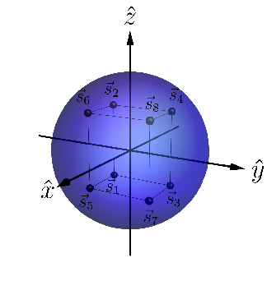
Main result
Generalization to three measurements
In any operational theory, if one can find a triple of measurements, and a state that satisfies the condition of , then noncontextuality implies that
Example of
in qubit theory:
25/27
Notes:
Noise robust. It can be tested experimentally.
So the UR it’s a NC inequality. It’s not about a single state as you could pick any in the A12 orbit realizability.

Slide 33
Main result
Generalization to three measurements
26/27
Notes:
Noise robust. It can be tested experimentally.
So the UR it’s a NC inequality. It’s not about a single state as you could pick any in the A12 orbit realizability.

Slide 34
Contents
Motivation
Uncertainty relations
Operational theories
Ontological models and Noncontextuality
Main result
Conclusion

Slide 35
Conclusion
Under the condition of , noncontextuality bounds the functional form of the ZX predictability tradeoff below a linear curve.
The functional form of an uncertainty relation can witness contextuality.
If one takes noncontextuality as the notion of classicality, it is not the lack of perfect joint ZX predictability that witnesses nonclassicality, but the greater joint predictability for states satisfying .
Follow-up work: what is nonclassical about interference phenomena?
arXiv:2207.11779
27/27
Notes:
For theories where this condition applies to all states, the predictability tradeoff is an UR and so it is the functional form of UR that can witness contextuality.
So it is the functional form above the linear curve of quantum UR that captures its nonclassicality. At least in the sense of contextuality.
It is usually thought that the lack of perfect predictability that witness nonclassicality, e.g. in quantum theory. However if one takes nonclassicality as contextuality, it is quite different. It is the greater joint predictability for states satisfying the A12 symmetry that witness nonclassicality.

Slide 36
Extra slides

Slide 37
Main result
The noncontextual bound
25/23
Notes:
If we draw without modules, we really see that the noncontextual bound corresponds to the edges of the stabilizer square in the ZX plane, and which is contained in the Bloch circle. It is also the state space of the closure of Spekkens toy theory.

Slide 38
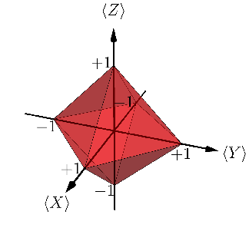
Main result
The case of three measurements
26/23
Notes:
Noise robust. It can be tested experimentally.
So the UR it’s a NC inequality. It’s not about a single state as you could pick any in the A12 orbit realizability.

Slide 39
Some references
This work :
Epistemically restricted theories :
What’s truly nonclassical about quantum theory :
L. Catani, M. S. Leifer, D. Schmid, R. W. Spekkens, arXiv: 2111.13727 (2021).
R. W. Spekkens Phys Rev A 75 (3): 032110 (2007).
S. Bartlett, T. Rudolph, R. W. Spekkens, Phys Rev A 86, 012103 (2012).
R. W. Spekkens, in Quantum Theory: Informational Foundations and Foils, pp 83-135, Springer Dordrecht (2016).
L. Catani, D. E. Browne, New J. Phys. 19, 073035 (2017).
L. Catani, M. S. Leifer, arXiv:2003.10050 (2020).
D. Schmid, J. Selby, R. W. Spekkens, arXiv:2009.03297 (2020).

Slide 40
What is non-classical about quantum interference?
In a follow-up work we show that the precise trade-off between visibility of fringes and which-way distinguishability in any preparation noncontextual model is linear, , while in quantum theory it is quadratic (Englert inequality), .
Notes:
We want to understand quantum theory. In order to do so we think we need to single out the features that are inherently nonclassical of quantum theory. In this work we show that interference phenomena are not among those features, unlike usually claimed, by providing a classical statistical theory – the toy field theory -- that reproduces those phenomena within a classical worldview (explicitly refuting all the radical interpretational claims that are usually taken to be implied by quantum interference phenomena). With this work we also want to promote a more rigorous way of studying nonclassicality.

Slide 41
What is non-classical about quantum interference?
It is possible to provide a classical account of the TRAP phenomenology of quantum interference. However, reproducing the precise trade-off between visibility and distinguishability in quantum theory requires contextuality.
Notes:
We want to understand quantum theory. In order to do so we think we need to single out the features that are inherently nonclassical of quantum theory. In this work we show that interference phenomena are not among those features, unlike usually claimed, by providing a classical statistical theory – the toy field theory -- that reproduces those phenomena within a classical worldview (explicitly refuting all the radical interpretational claims that are usually taken to be implied by quantum interference phenomena). With this work we also want to promote a more rigorous way of studying nonclassicality.

